Slide 1
SELECTIVE SEARCH TECHNIQUE
Sumedh Datar Akhil Ghosh

Slide 2
Selective Search For Object Detection
Paper was presented in International Journal of Computer Vision (IJCV) - 2013

Slide 3
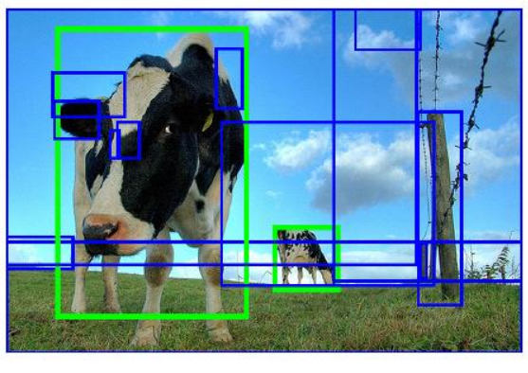
What is selective search technique?
Selective Search is a region proposal algorithm used in object detection.
It is designed to be fast with a very high recall.

Slide 4
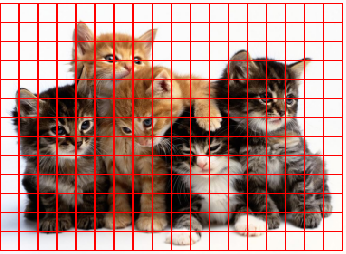
Segmentation techniques
Idea: Exhaustive search for objects.
Problem: Extremely slow, must process tens of thousands of candidate objects.

Slide 5


Segmentation Techniques
Idea: Need a generic segmentation algorithm.
Problem: We may have to use separate segmentation algorithms for each object.

Slide 6
Advantages Selective Search Technique?
Can build a generic segmentation technique using region proposals.
Object localization.
Performance of selective search is fast compared to other region proposal algorithms.
Support object recognition.

Slide 7
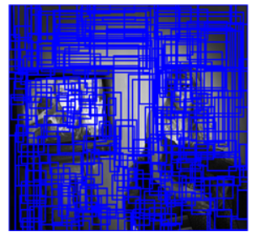
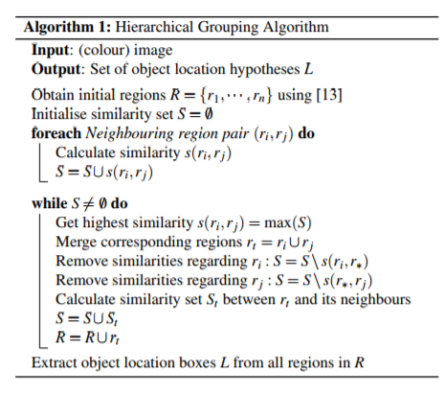
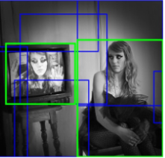
Algorithm Pseudocode

Slide 8

Algorithm Working
Step 1 : Generate initial sub-segmentation
Segmenting the image based on intensity of the pixels using a graph based segmentation method.

Slide 9

Algorithm Working
Step 2: Recursively combine similar regions into larger ones. GREEDY ALGORITHM : 1. From set of regions, choose two that are most similar.
2. Combine them into single larger regions.
3. Repeat until only one region remains.

Slide 10
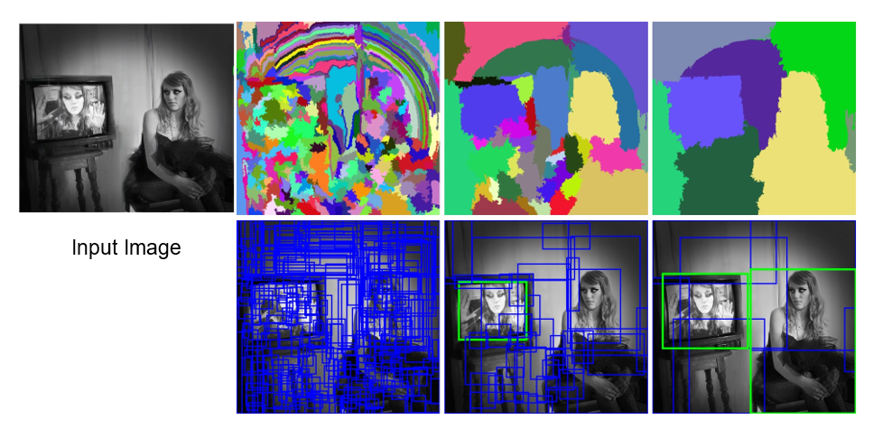
Algorithm Working
Step 3 : Use the generated regions to produce candidate object locations.

Slide 11
TIME COMPLEXITY
O(n)

Slide 12
References
https://ivi.fnwi.uva.nl/isis/publications/2013/UijlingsIJCV2013/UijlingsIJCV2013.pdf
https://www.learnopencv.com/selective-search-for-object-detection-cpp-python/
https://www.koen.me/research/pub/vandesande-iccv2011-poster.pdf

Slide 13
THANK YOU

